Slide 1
Lyme Disease
NURS 5012 Global Health Awareness
King University
Dr. Teresa Sellstorm
Presented by: Chelsea Hammond & Erica Miller

Slide 2
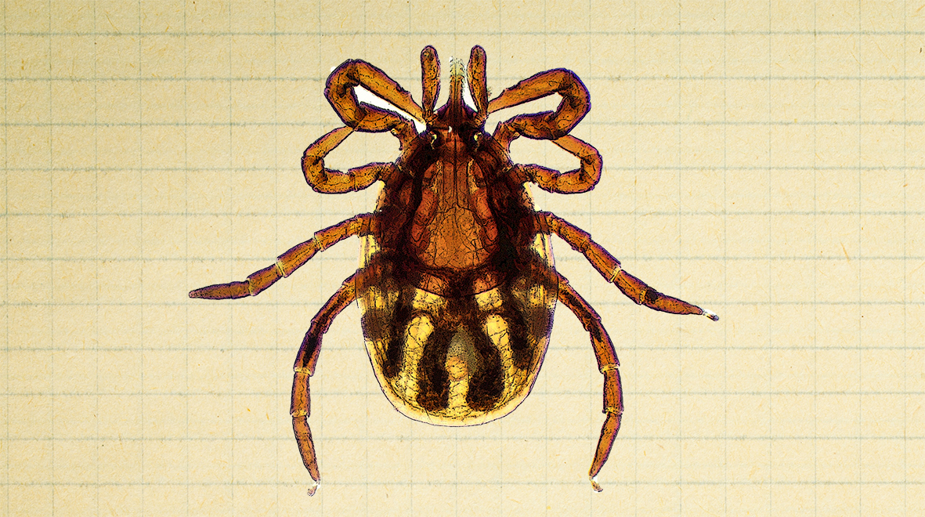
Background
Tick-borne illnesses are transmitted to humans by infected species of ticks. Lyme disease is specifically transmitted via Ixodes ticks which are infected with the causative agent Borrelia burgdorferi (Bb).
Lyme Disease is a common tick-borne disease in the United States.
Primary care providers should be suspicious of and include tick-borne diseases as differential diagnoses for individuals with influenza-like symptoms (fever, headache, myalgia) during summer as it is an unusual time for these symptoms, especially for individuals who live and/or recreate outdoors.
If left untreated, Lyme Disease can cause serious, life-long health problems and permanent damage.
(Dawn Lee Garzon et al., 2023)

Slide 3
Clinical Findings
Lyme Disease presents a variety of symptoms and has 3 stages:
Stage 1 (early localized disease):
A classic rash generally appears at the inoculation site within days to weeks after the bite, known as erythema migrans (EM). The rash begins as a red, annular macule or papule surrounded by a clear ring and then a larger, erythematous outer ring – appearing as a “bull’s eye”. To meet diagnostic criteria for EM, the rash needs to be at least 5 cm in size. EM is typically painless, warm, and nonpruritic, remains visible for a few weeks, and then fades even if left untreated. In some cases, the rash may not follow this classic pattern and can present similarly to cellulitis. Symptoms that accompany EM include fever, malaise, headache, arthralgia, myalgia, and mild nuchal rigidity. Without treatment, these symptoms can become intermittent and last for weeks to months.
Stage 2 (early disseminated disease):
The primary organism responsible for Lyme Disease, Bb, disseminates through hematologic or lymphatic channels. Multiple secondary lesions can appear in this stage that are typically similar in appearance but are smaller. Symptoms can present, with or without lesions, including cranial nerve palsies (most common in cranial nerve VII), lymphocytic meningitis, radiculitis, carditis with life-threatening arrhythmias (first, second, and third-degree AV block), and generalized illness (stomach aches, urinary symptoms, migratory musculoskeletal pains). Stage 2 lasts from weeks up to 2 years without treatment and most symptoms wax and wane during this time.
Stage 3 (late disease):
Illnesses treated with antibiotic therapy during the early stages do not generally develop late-stage 3 manifestations. Stage 3 occurs when the disease is not treated in stage 1 or 2 and generally manifests as arthritis affecting the large joints, most commonly the knees, cognitive and memory loss, and paresthesia of the hands and feet. Concrete evidence of lyme arthritis includes the presence of WBCs in the synovial fluid. Untreated, arthritis initially resolves in a few weeks but becomes recurrent and chronic. A late manifestation of this disease appears months to years after the initial infection.
(Dawn Lee Garzon et al., 2023)

Slide 4
Introduction of Disease in the United States
Lyme Disease is the most reported vector-borne infection in the United States.
In 2017, there were 29,515 confirmed cases in the U.S. with a real concern for significant underreporting.
Bb-infected ticks are predominantly found in the northeast section of the U.S., accounting for approximately 80% of cases, in areas including the mid-Atlantic states, Wisconsin, Minnesota, and Northern California.
(Dawn Lee Garzon et al., 2023)

Slide 5
What is currently being done to eradicate this disease?
Prevention
There is no vaccine to protect individuals in the U.S. from Lyme Disease.
The best way to to prevent Lyme Disease is to avoid tick bites when you are outdoors, using strategies such as using tick repellent, dressing for protection, checking for ticks, and staying on clear paths as much as possible, avoiding wooded and grassy areas.
Antibiotics may be prescribed as preventative measure if the biting tick is known to be a deer tick, individual lives in or recently visited an area where Lyme Disease is common, and the tick was attached to to skin for 36 hours or more.
Treatment
The standard treatment for Lyme Disease is an antibiotic taken as a pill, and the treatment usually lasts 10 to 14 days. Treatment may last longer depending on severity of illness and symptoms. Intravenous (IV) antibiotics may be prescribed for more serious illness, especially in cases with long-lasting arthritis, disease affecting the nervous system, and/or disease affecting the heart.
Antibiotics are the only proven treatment for Lyme Disease.
(Mayo Clinic, 2023)

Slide 6
Involvement of World Health Organizations
Centers for Disease and Control (CDC)
According to the CDC, over 63,000 cases of Lyme Disease were reported in 2022 by state health departments and the District of Columbia. This number reflects cases reported through routine national surveillance. Recent estimates using other methods suggest that approximately 476,000 people may be diagnosed and treated for Lyme Disease each year in the U.S. (CDC, 2024).
Lyme Disease has been a nationally notifiable condition in the U.S. since 1991. Reports of Lyme Disease are routinely collected and verified by state and local health departments in accordance with legal mandate and surveillance practices (CDC, 2024).
World Health Organization (WHO)
The WHO established The Global Vector Control Response (GVCR) 2017-2030 in 2017 to provide strategic guidance to countries for urgent strengthening of vector control as a fundamental approach to preventing disease and responding to outbreaks (World Health Organization, 2020).

Slide 7
Problems encountered
Lyme disease brings many challenges that significantly impact both individuals and public health. One major issue is the delay in diagnosis; the symptoms can be vague and mimic those of other illnesses, which often leads to misdiagnosis or delayed treatment. Some patients may continue to experience persistent symptoms like fatigue, joint pain, and cognitive difficulties, even after treatment, a condition referred to as "Post-Treatment Lyme Disease Syndrome" (PTLDS). While antibiotics can be effective early on, options for treating chronic Lyme disease are still unclear, leaving some people with ongoing health issues. Public awareness is also big; many folks don't know much about Lyme disease, its symptoms, or how to prevent it, which only raises the risk of infection. On top of that, patients dealing with chronic symptoms often face skepticism from healthcare providers and the public, making it tough for them to get the support they need. The financial burden is significant as well, as costs for treatment, long-term care, and lost productivity can add up. Plus, managing tick populations and preventing Lyme disease transmission is complicated due to the intricacies of ecosystems and human behavior. With Lyme disease spreading to areas where it used to be uncommon, prevention efforts become even more challenging. All these issues highlight the need for better awareness, improved diagnostic tools, and effective management strategies to tackle Lyme disease (CDC, 2024).
Another issue we face is that there is currently no vaccine available for Lyme disease, as the only one previously marketed in the U.S., LYMERix®, was discontinued in 2002 due to low consumer demand. If you received this vaccine before its discontinuation, you are no longer protected against Lyme disease, as its effectiveness diminishes over time (CDC, 2024).

Slide 8
Implications of Disease
Lyme disease can lead to serious issues like chronic fatigue, joint pain, neurological problems, and heart issues, all of which can affect your quality of life.
People often need more medical care due to these complications, which can create a heavy financial burden from treatment costs and lost work.
Dealing with chronic symptoms can lead to anxiety and depression, adding another layer of difficulty for those affected.
Lyme disease puts pressure on healthcare resources and highlights the need for better prevention and education efforts.
The disease is popping up in areas where it used to be rare, making it even harder to raise awareness and implement prevention strategies.
All these implications show just how crucial it is to develop effective management strategies, boost public awareness, and continue researching Lyme disease.
(CDC, 2024)

Slide 9
References
Centers for Disease Control and Prevention. (2024). Lyme disease. Retrieved from https://www.cdc.gov/lyme/
CDC. (2024, May 20). Testing and Diagnosis for Lyme disease. Lyme Disease. https://www.cdc.gov/lyme/diagnosis-testing/index.html
Centers for Disease Control and Prevention. (2024, May 15). Lyme disease vaccine. Retrieved from https://www.cdc.gov/lyme/about/lyme-disease-vaccine.html
Dawn Lee Garzon, Dirks, M., Driessnack, M., Duderstadt, K. G., & Gaylord, N. M. (2023). Burns’ Pediatric Primary Care - E-Book. Elsevier Health Sciences.
Mayo Clinic. (2023, February 10). Lyme Disease - Symptoms and Causes. Mayo Clinic; Mayo Clinic. https://www.mayoclinic.org/diseases-conditions/lyme-disease/symptoms-causes/syc-20374651
World Health Organization. (2020, March 2). Vector-borne diseases. Who.int; World Health Organization: WHO. https://www.who.int/news-room/fact-sheets/detail/vector-borne-diseases

