Slide 1
Middle Range Theory Teaching Tool
Theory Name: Postpartum Depression Theory
Student Name: Erica Miller

Slide 2
Introduction of Theory
Cheryl Beck has made remarkable discoveries in understanding postpartum depression (PPD) through qualitative research. Her theory highlights the nature of PPD, emphasizing how personal and social factors contribute to its development. Beck introduces crucial concepts like the "postpartum depression trajectory" and "reproductive identity," which reflect the deep impact of childbirth on women's mental health. These insights are crucial for improving how we screen, diagnose, and support women experiencing PPD.
Beck's work fits well with the broader nursing theories discussed by McEwen and Wills (2022), who stress the importance of understanding the intricate interplay of biological, psychological, and social factors in health. McEwen and Wills (2022) highlight how theories like Beck's guide research and practice by offering valuable perspectives on how individual experiences and societal influences shape health outcomes. Incorporating Beck's concepts into clinical practice mirrors the principles from McEwen and Wills, advocating for a comprehensive approach to mental health that enhances patient care through evidence-based practice.

Slide 3
Cheryl Beck
Beck is a distinguished researcher and professor specializing in nursing and women's health. She holds a PhD in Nursing and is known for her extensive work in maternal mental health, particularly postpartum depression (Beck, n.d.).
Her academic background includes a foundation in nursing, research methodology, and women's health issues. Beck's expertise is further demonstrated through her development of the Postpartum Depression Theory, which offers a comprehensive framework for understanding the complexities of postpartum depression (Marsh, 2013).
Beck's contributions have not only significantly impacted nursing practice and research but have also led to the development of interventions that enhance the mental health and well-being of new mothers (Beck, n.d.). Her work serves as an inspiration for all in the field.

Slide 4
What is The Postpartum Depression Theory?
Postpartum depression (PPD) is a tough mental health challenge that hits some women after giving birth. The theory behind it points to a mix of biological, psychological, and social factors.
hormonal shifts after childbirth, such as a sudden drop in estrogen and progesterone, play a significant role in disrupting mood. On top of that, the physical strain of delivery, the new responsibilities of motherhood, and lack of sleep can make feelings of stress and inadequacy even worse.
From a psychological angle, personal expectations and adjusting to the role of being a mom play a big part. Women who’ve struggled with depression or anxiety before, or those who don’t have strong support from family and friends, are more at risk. Social stressors like financial worries or a weak support network can also make things harder. McEwen and Wills (2022) highlight how understanding these different factors helps in creating effective treatment and support strategies for those dealing with PPD.

Slide 5
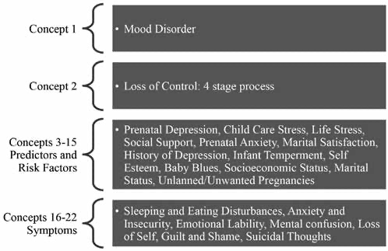
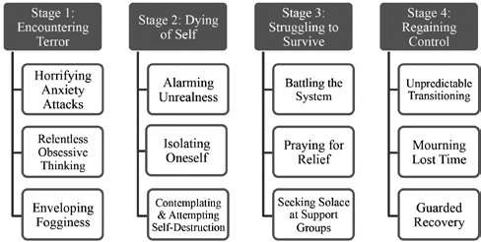
Diagrams to The Postpartum Depression Theory
Figure 1. Beck’s 4 Stage Process of Postpartum Depression Encompassing Loss of control
Figure 2. Beck’s twenty-two Key Propositions Related to Postpartum Depression
(Marsh, 2013)

Slide 6
Application of Theory to Nursing Practice:
One way to implement Cheryl Beck's Postpartum Depression Theory would be by developing integrated screening models in maternity care. Picture a hospital setting up a comprehensive screening program that uses Beck's ideas, like the '"Postpartum Depression Trajectory'" model. This model would enable the creation of a screening tool that tracks women at different stages—before, during, and after childbirth. Instead of just identifying immediate postpartum symptoms, this tool would also monitor changes over time, making it easier to offer early intervention and crucial ongoing support, a key element in the effective management of postpartum depression.
We could set up routine screenings during prenatal and postpartum visits to make this work. These screenings would focus on critical aspects like reproductive identity and cognitive distortions, which are crucial to Beck's theory. According to Marsh (2013), using middle-range theories like Beck's in everyday practice can boost the effectiveness of these screenings by offering a straightforward method for spotting and tackling postpartum depression (pp. 50–54). Healthcare providers would get training to identify these issues and give personalized support tailored to each woman's needs. This might involve counseling, connecting new mothers with support groups, and providing educational resources to address their specific challenges, aligning with Marsh's (2013) approach to applying theoretical insights to enhance patient care (pp. 50–54).

Slide 7
Summary
Cheryl Beck is a standout nurse researcher who has made significant strides in understanding postpartum depression (PPD). Her in-depth research has led to a theory that captures the intricate nature of PPD and the critical role of both personal and social factors (Marsh, 2013). Beck’s main ideas, such as the "postpartum depression trajectory," show how PPD symptoms can change over time, while "reproductive identity" explores how becoming a mother affects mental health. Her work has pushed the envelope in how we screen, diagnose, and support women with PPD, leading to noticeable improvements in clinical practices and patient care.
With her strong background in nursing and maternal mental health, bolstered by a PhD and extensive research, Beck's theory offers a deep dive into PPD (Marsh, 2013). Her framework breaks down PPD through concepts like the "Postpartum Depression Trajectory" and "Reproductive Identity" and uses the Stress Process Model to explain how stressors and personal resources impact PPD. Her focus on cognitive distortions and the importance of social support adds even more depth, with visual tools like the Trajectory and Reproductive Identity Diagrams making these complex interactions more specific (Marsh, 2013)

Slide 8
References
Beck, C. (n.d.). Cheryl Beck. University of Connecticut School of Nursing. https://nursing.uconn.edu/person/cheryl-beck/
Marsh, J. (2013). A Middle Range Theory of Postpartum Depression: Analysis and Application. International Journal of Childbirth Education, 28(4), 50–54.
McEwen, M., & Wills, E. M. (2022). Theoretical basis for nursing (6th ed.). Wolters Kluwer Health.

